Slide 1


Dream Bus: Improving Teenagers' Accessibility of Service via Mobile Library
Zishan Bai & Dingyi Zhou

Slide 2
01
Covid-19 Impact
PPT模板下载：www.1ppt.com/moban/ 行业PPT模板：www.1ppt.com/hangye/
节日PPT模板：www.1ppt.com/jieri/ PPT素材下载：www.1ppt.com/sucai/
PPT背景图片：www.1ppt.com/beijing/ PPT图表下载：www.1ppt.com/tubiao/
优秀PPT下载：www.1ppt.com/xiazai/ PPT教程： www.1ppt.com/powerpoint/
Word教程： www.1ppt.com/word/ Excel教程：www.1ppt.com/excel/
资料下载：www.1ppt.com/ziliao/ PPT课件下载：www.1ppt.com/kejian/
范文下载：www.1ppt.com/fanwen/ 试卷下载：www.1ppt.com/shiti/
教案下载：www.1ppt.com/jiaoan/ PPT论坛：www.1ppt.cn
Station
How can the schedule of the Dream bus be improved?
Time
Outline
02
How accessible of Dream Bus after adding stations?
Dream Bus
What kind of items should be added into Dream Bus?
03
Conclusion

Slide 3
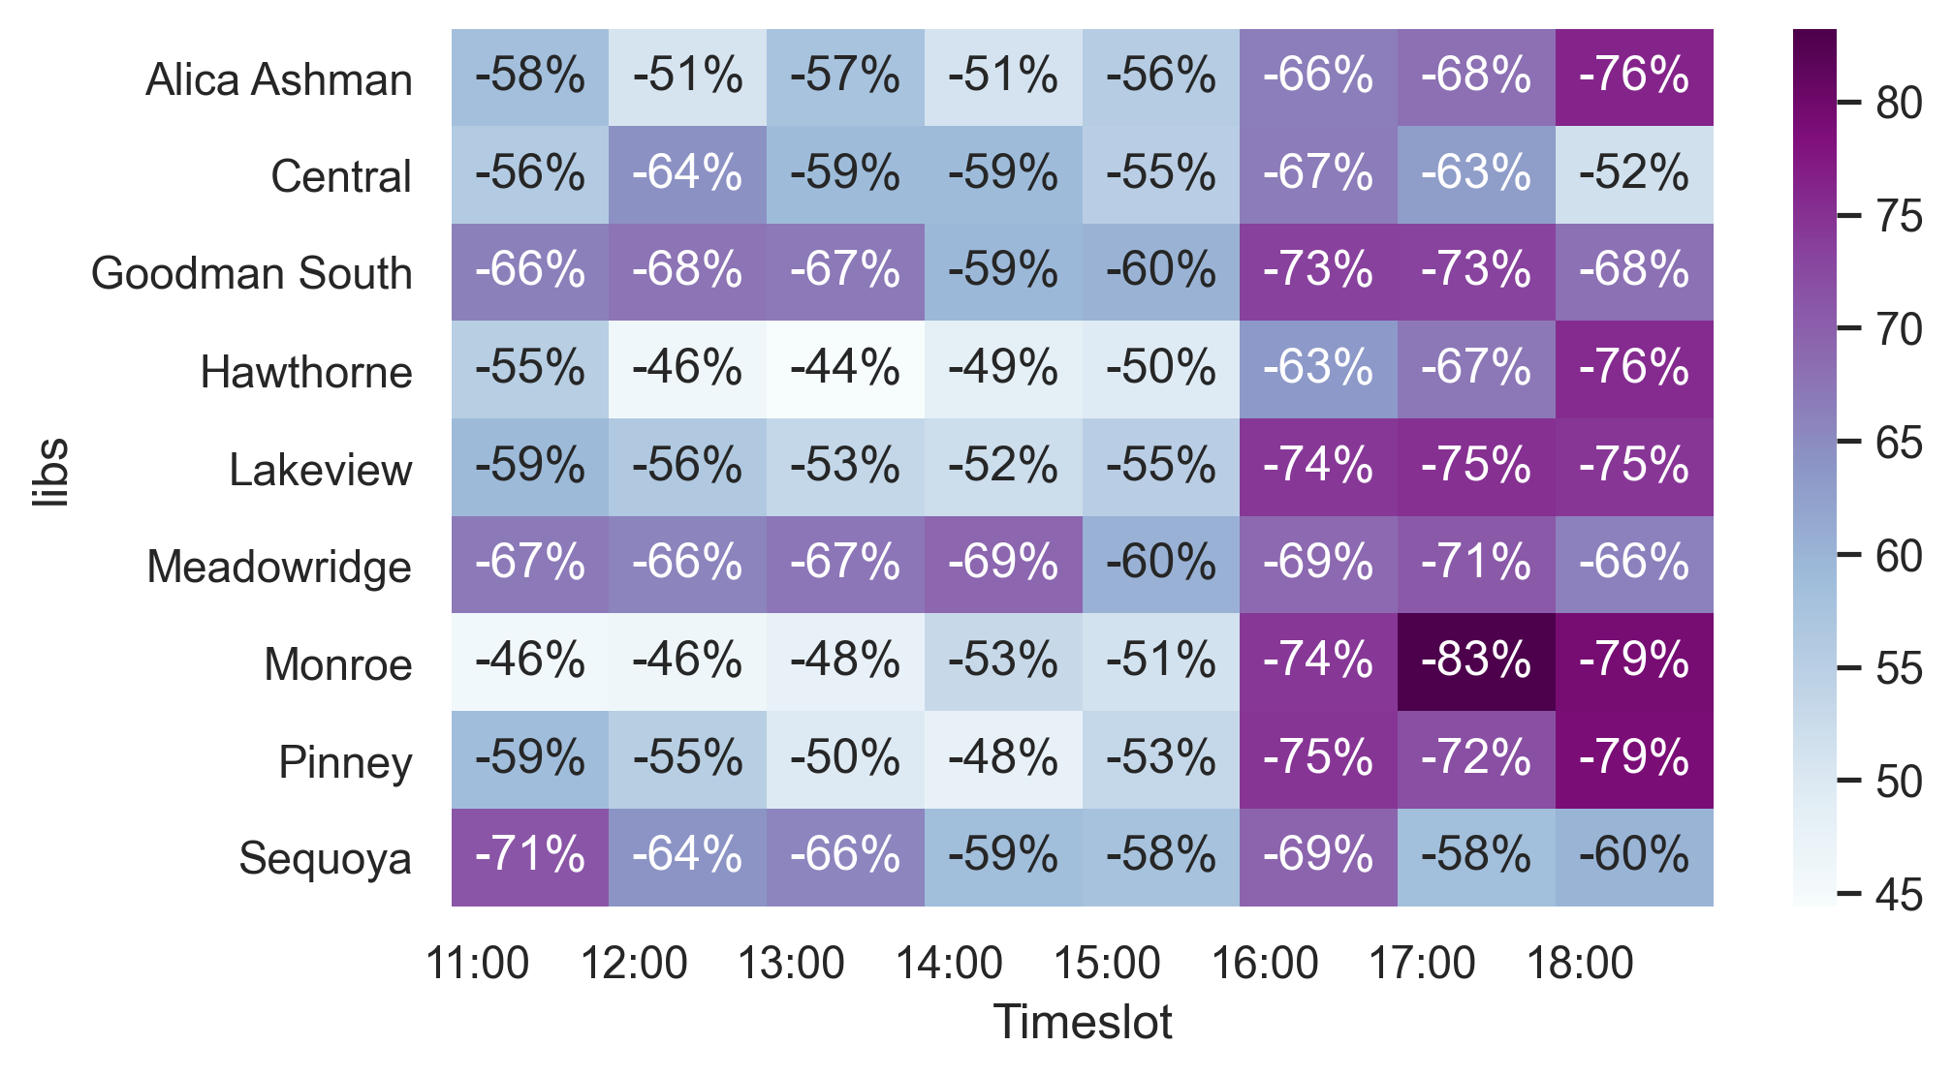
Circulation Drop following COVID-19 Outbreak
Huge Decrease

Slide 4
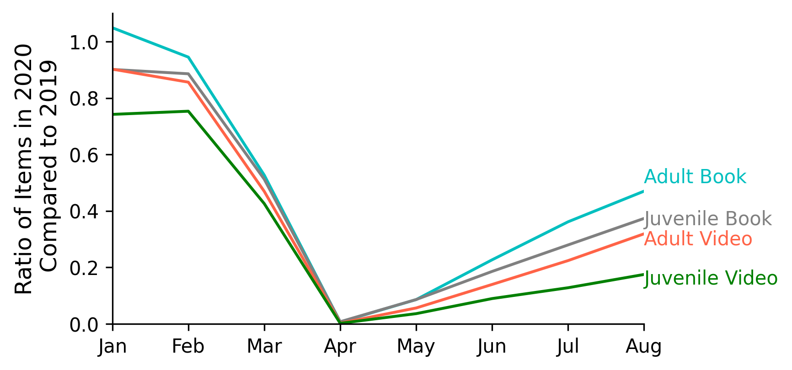
Circulation Proportion of 2020 in Different Age Group
Vulnerable
Juvenile Circulation

Slide 5
01
Covid-19 Impact
PPT模板下载：www.1ppt.com/moban/ 行业PPT模板：www.1ppt.com/hangye/
节日PPT模板：www.1ppt.com/jieri/ PPT素材下载：www.1ppt.com/sucai/
PPT背景图片：www.1ppt.com/beijing/ PPT图表下载：www.1ppt.com/tubiao/
优秀PPT下载：www.1ppt.com/xiazai/ PPT教程： www.1ppt.com/powerpoint/
Word教程： www.1ppt.com/word/ Excel教程：www.1ppt.com/excel/
资料下载：www.1ppt.com/ziliao/ PPT课件下载：www.1ppt.com/kejian/
范文下载：www.1ppt.com/fanwen/ 试卷下载：www.1ppt.com/shiti/
教案下载：www.1ppt.com/jiaoan/ PPT论坛：www.1ppt.cn
Station
How can the schedule of the Dream bus be improved?
Time
Outline
02
How accessible of Dream Bus after adding stations?
Dream Bus
What kind of items should be added into Dream Bus?
03
Conclusion

Slide 6
How can the schedule of the Dream bus be improved?
Improve accessibility for teenagers
Add New Stations
Our Goals
Divert visits from busy libraries (social distancing)
New Time Slots

Slide 7
How can the schedule of the Dream bus be improved?
Add Station:
The percentage of teenager in each community
No Library: Red circles on the left and Right
Busy Stationary Library: Red circles in the middle

Slide 8
How can the schedule of the Dream bus be improved?

Slide 9
01
Covid-19 Impact
PPT模板下载：www.1ppt.com/moban/ 行业PPT模板：www.1ppt.com/hangye/
节日PPT模板：www.1ppt.com/jieri/ PPT素材下载：www.1ppt.com/sucai/
PPT背景图片：www.1ppt.com/beijing/ PPT图表下载：www.1ppt.com/tubiao/
优秀PPT下载：www.1ppt.com/xiazai/ PPT教程： www.1ppt.com/powerpoint/
Word教程： www.1ppt.com/word/ Excel教程：www.1ppt.com/excel/
资料下载：www.1ppt.com/ziliao/ PPT课件下载：www.1ppt.com/kejian/
范文下载：www.1ppt.com/fanwen/ 试卷下载：www.1ppt.com/shiti/
教案下载：www.1ppt.com/jiaoan/ PPT论坛：www.1ppt.cn
Station
How can the schedule of the Dream bus be improved?
Time
Outline
02
How accessible of Dream Bus after adding stations?
Dream Bus
What kind of items should be added into Dream Bus?
03
Conclusion

Slide 10
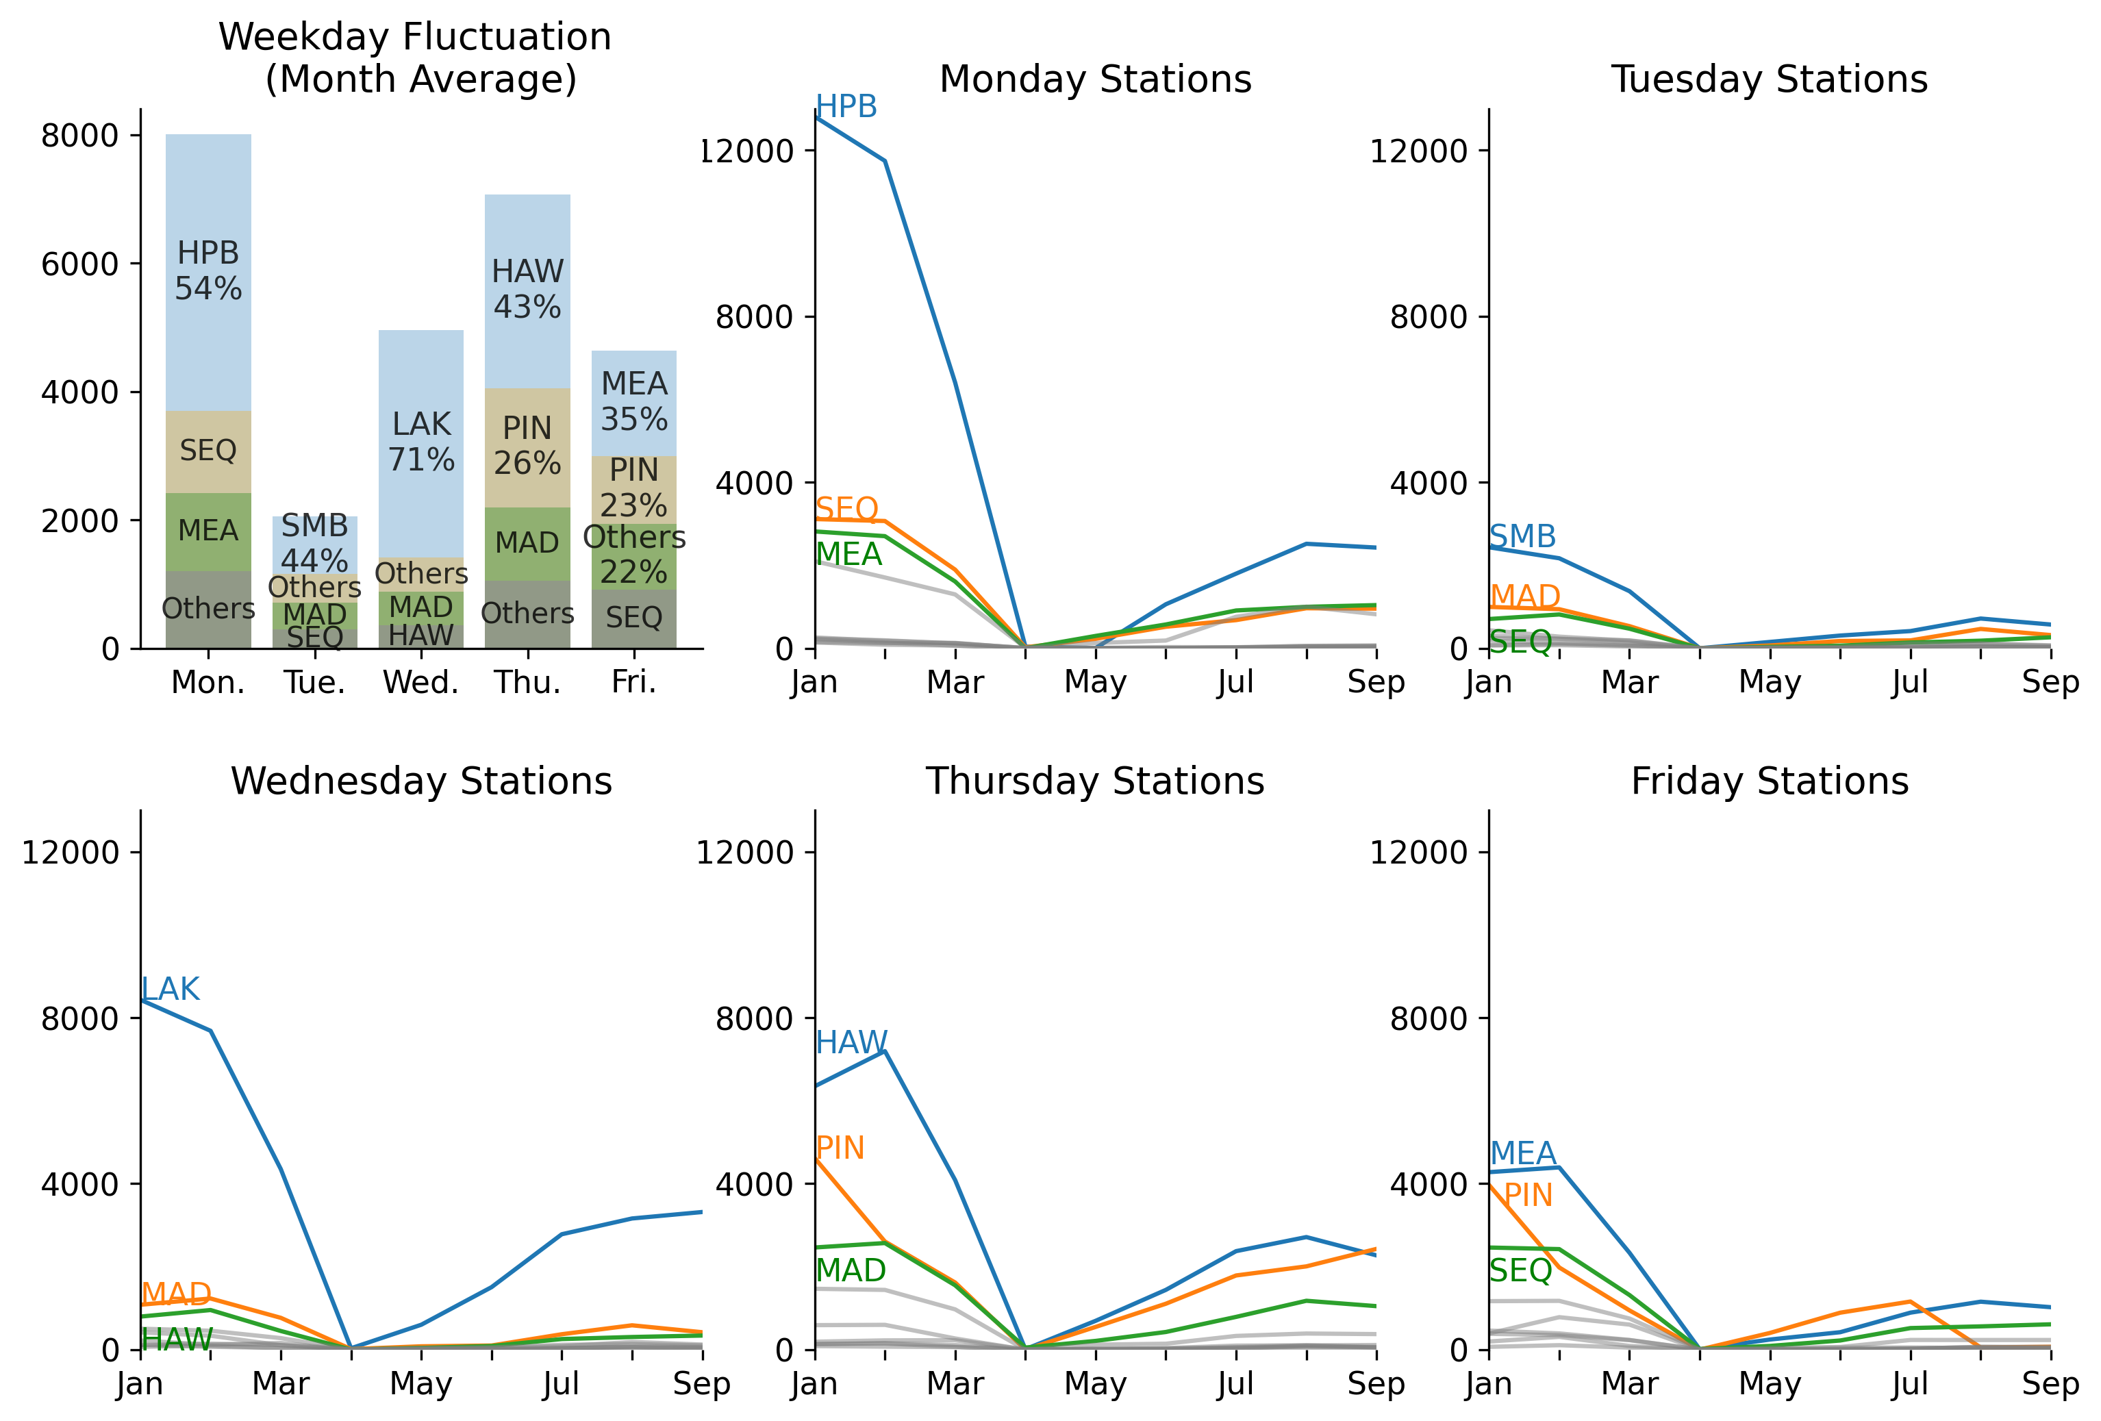
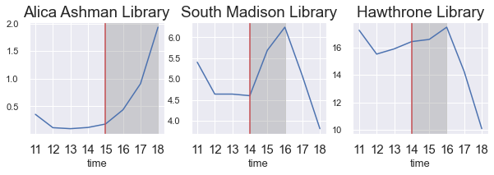
How can the schedule of the Dream bus be improved?
Time Arrangement:
Which stationary library’s patron flow could be substituted by Dream Bus routes?

Slide 11
How can the schedule of the Dream bus be improved?
Time Arrangement:
Extend the time range with more patron flow

Slide 12
01
Covid-19 Impact
PPT模板下载：www.1ppt.com/moban/ 行业PPT模板：www.1ppt.com/hangye/
节日PPT模板：www.1ppt.com/jieri/ PPT素材下载：www.1ppt.com/sucai/
PPT背景图片：www.1ppt.com/beijing/ PPT图表下载：www.1ppt.com/tubiao/
优秀PPT下载：www.1ppt.com/xiazai/ PPT教程： www.1ppt.com/powerpoint/
Word教程： www.1ppt.com/word/ Excel教程：www.1ppt.com/excel/
资料下载：www.1ppt.com/ziliao/ PPT课件下载：www.1ppt.com/kejian/
范文下载：www.1ppt.com/fanwen/ 试卷下载：www.1ppt.com/shiti/
教案下载：www.1ppt.com/jiaoan/ PPT论坛：www.1ppt.cn
Station
How can the schedule of the Dream bus be improved?
Time
Outline
02
How accessible of Dream Bus after adding stations?
Dream Bus
What kind of items should be added into Dream Bus?
03
Conclusion

Slide 13
How accessible of Dream Bus after adding stations and extending schedule?
Our Goals
Go to the closest stations more easily

Slide 14
How the distribution of Dream Bus can be improved?
Top 10: away from closest station within 2 kilometers

Slide 15
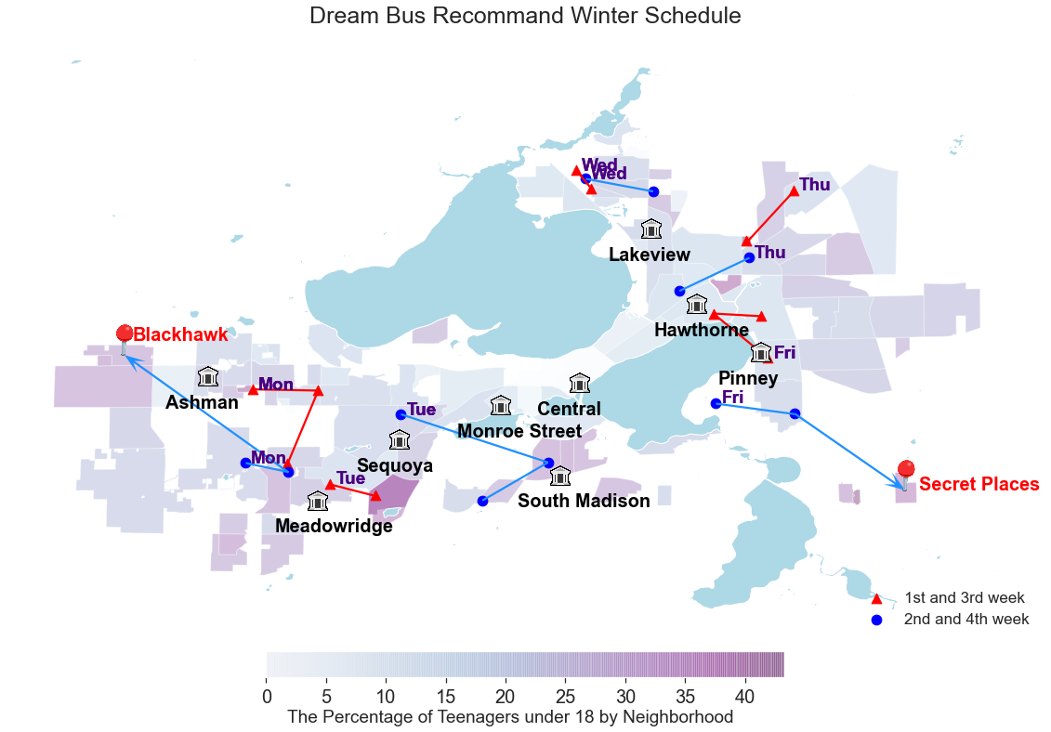
Winter Schedule
Only two new stations, effective as well

Slide 16
01
Covid-19 Impact
PPT模板下载：www.1ppt.com/moban/ 行业PPT模板：www.1ppt.com/hangye/
节日PPT模板：www.1ppt.com/jieri/ PPT素材下载：www.1ppt.com/sucai/
PPT背景图片：www.1ppt.com/beijing/ PPT图表下载：www.1ppt.com/tubiao/
优秀PPT下载：www.1ppt.com/xiazai/ PPT教程： www.1ppt.com/powerpoint/
Word教程： www.1ppt.com/word/ Excel教程：www.1ppt.com/excel/
资料下载：www.1ppt.com/ziliao/ PPT课件下载：www.1ppt.com/kejian/
范文下载：www.1ppt.com/fanwen/ 试卷下载：www.1ppt.com/shiti/
教案下载：www.1ppt.com/jiaoan/ PPT论坛：www.1ppt.cn
Station
How can the schedule of the Dream bus be improved?
Time
Outline
02
How accessible of Dream Bus after adding stations?
Dream Bus
What kind of items should be added into Dream Bus?
03
Conclusion

Slide 17
What kind of items should be added into Dream Bus?
Mitigate the circulation gap
Focus on the reduced circulation
Our Goals
Adjust for local popularity
Based on the readers’ preference

Slide 18
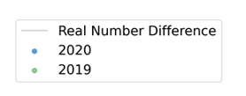
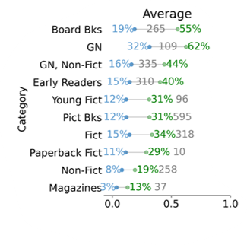
Book Categorize Turnover Rate Fluctuation
Turnover rate:
defined as the monthly average circulation divided by the total number of that category owned by the library
monthly average circulation
398
55% =
=
total number of that category
724
Turnover Rate

Slide 19
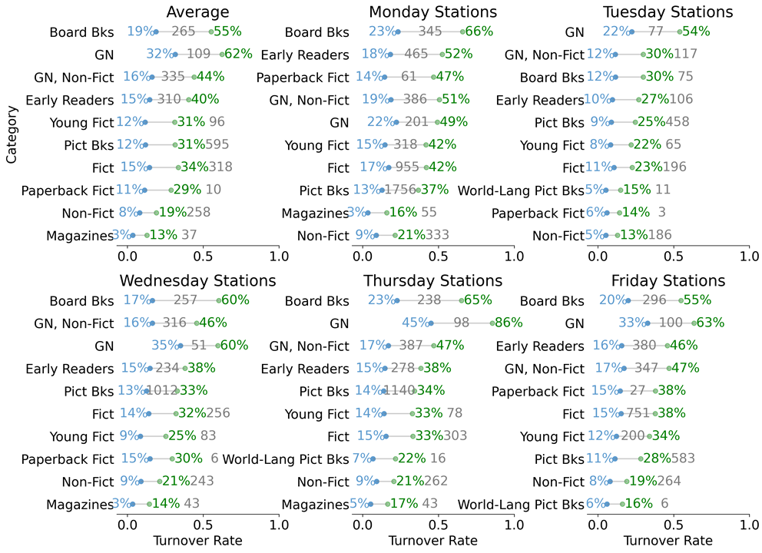
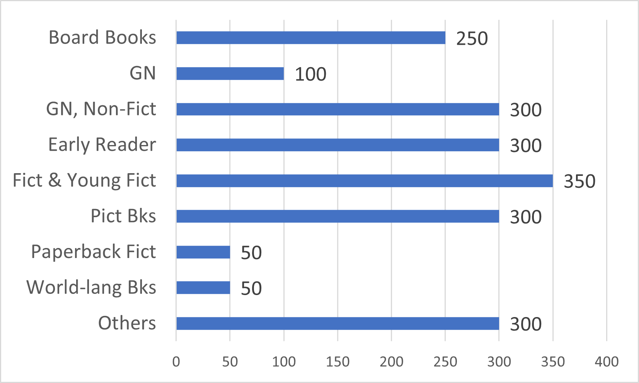
Book Categorize Turnover Rate Fluctuation
Turnover Rate

Slide 20
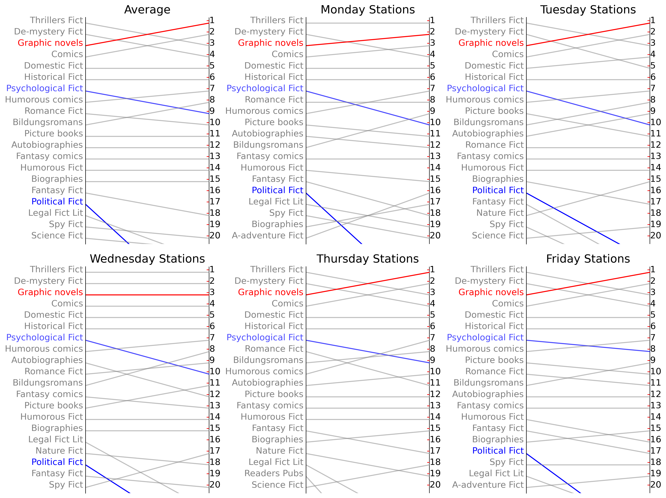
Graphic novels: Grow the most in both the rank and the real number
Psychological Fiction: Decline the most in the real number
Political Fiction: Decline the most in the rank
: daily adjustment
Book Gerne

Slide 21
01
Covid-19 Impact
PPT模板下载：www.1ppt.com/moban/ 行业PPT模板：www.1ppt.com/hangye/
节日PPT模板：www.1ppt.com/jieri/ PPT素材下载：www.1ppt.com/sucai/
PPT背景图片：www.1ppt.com/beijing/ PPT图表下载：www.1ppt.com/tubiao/
优秀PPT下载：www.1ppt.com/xiazai/ PPT教程： www.1ppt.com/powerpoint/
Word教程： www.1ppt.com/word/ Excel教程：www.1ppt.com/excel/
资料下载：www.1ppt.com/ziliao/ PPT课件下载：www.1ppt.com/kejian/
范文下载：www.1ppt.com/fanwen/ 试卷下载：www.1ppt.com/shiti/
教案下载：www.1ppt.com/jiaoan/ PPT论坛：www.1ppt.cn
Station
How can the schedule of the Dream bus be improved?
Time
Outline
02
How accessible of Dream Bus after adding stations?
Dream Bus
What kind of items should be added into Dream Bus?
03
Conclusion

Slide 22
Conclusion
Add four stations and revise the schedule
Ensure teenagers’ accessibility
Divert visits from busy libraries
Select 2700 items
Mitigate the circulation gap
Adjust for local popularity

Slide 23


Thanks!

Slide 24

Q&A

